Slide 1
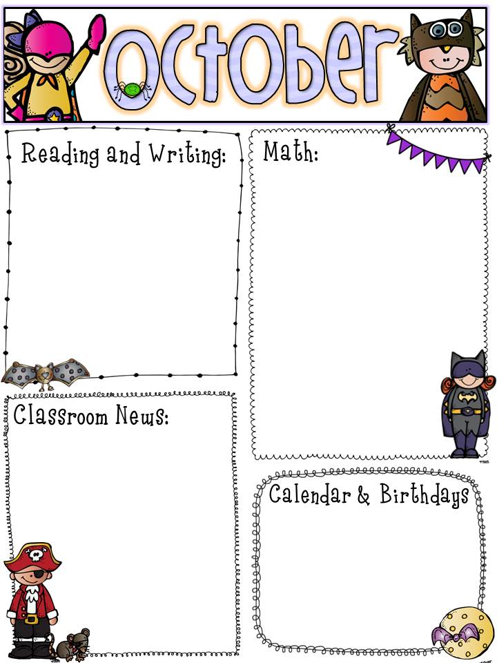
As we start our journey on unit 2, we will begin learning about characters, setting, and events. We will be working on short u this week and continue to learn new phonics sounds.
Chapter 2 is coming to an end. We will be taking our chapter 2 assessment this Friday and start working on chapter 3 next week. Chapter 3 will go back into adding and teach the students more ways to add up to 20.
Please make sure to sign reading homework daily. We have our Galileo testing this week. Please help make sure the students are getting a good breakfast and be ready to test.
10/2- Reading Galileo
10/3- Math Galileo
10/7- Kavin/ Lillee T. Birthday
10/8-10/12- Fall Break/ No School
10/11- Annabella’s Birthday
10/12- Cristian's Birthday
10/27- Jensis’s Birthday
10/17- Half Day
10/31- Half Day

