Slide 1
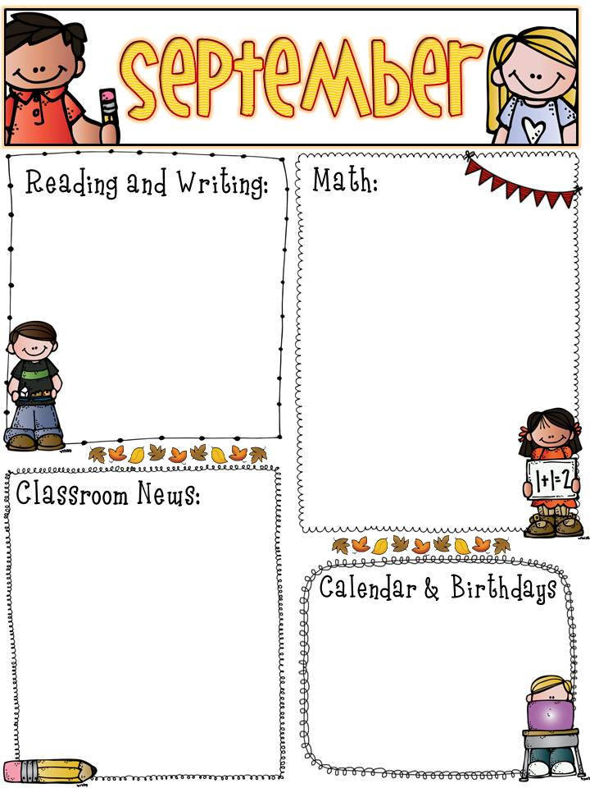
The students have begun switching for reading. The students are working on key details and understanding the story a little better. Each week we have a new phonics skill.
We will be finishing up addition within 20 and start subtracting within 20.
Please make sure that you are doing the reading and math homework daily with your student.
9/5- Half Day
9/7- Lily’s Birthday
9/11- Mrs. Brown’s Birthday
9/19- Half Day

