Slide 1
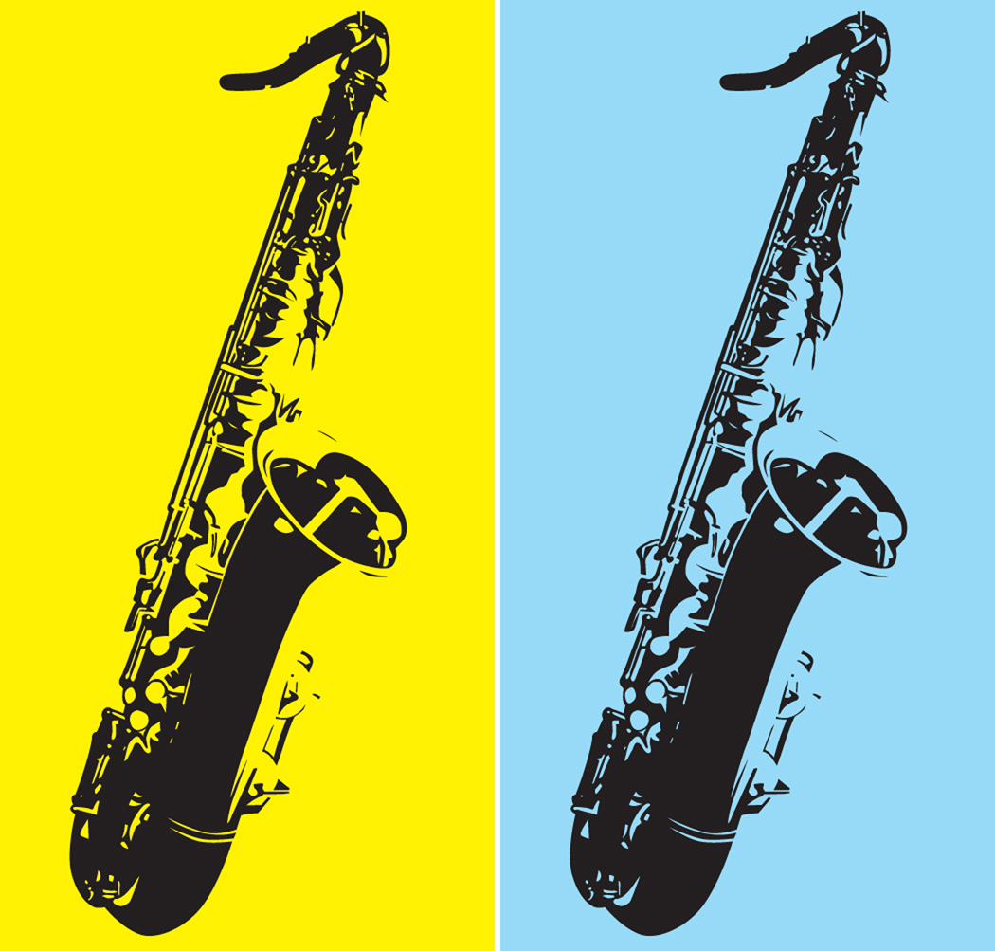

Instrumental Music Program
M.C. Cash School
And
Rogers Ranch School
Where Learning is Fun

Slide 2
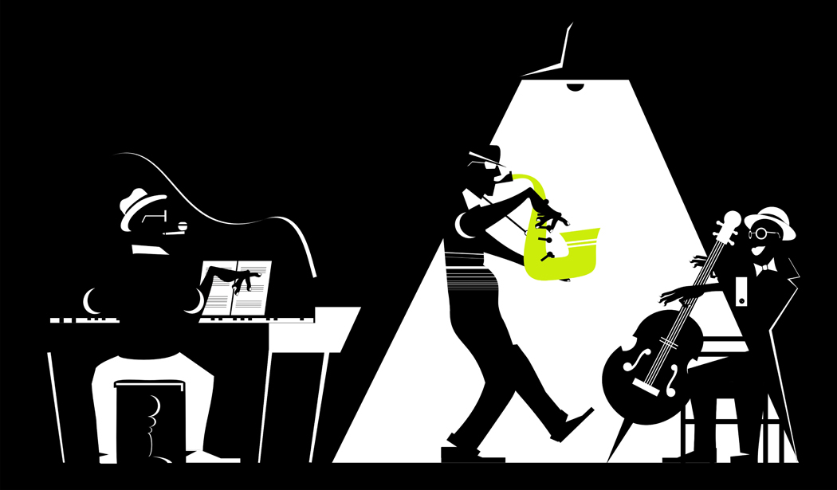
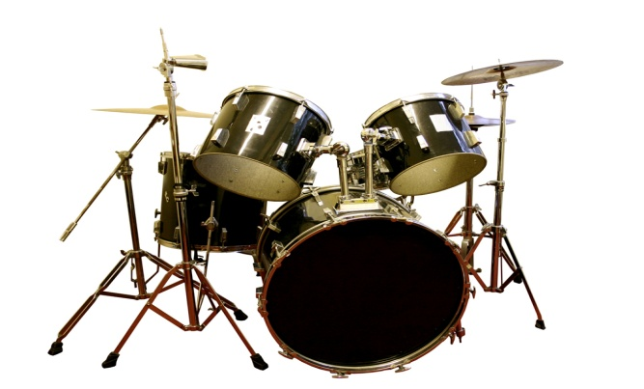

Band Classes Offered
8th grade
7th grade
6th grade
5th grade
Band instruments: Flute, Clarinet, Bass Clarinet, Alto Saxophone, Tenor Saxophone, Trumpet, Trombone, Baritone, Tuba, Percussion: Drums, Xylophone, Drum Set (7th and 8th grade)
Notes:
Band instruments: Flute, Clarinet, Bass Clarinet, Alto Saxophone, Tenor Saxophone, Trumpet, Trombone, Baritone, Tuba, Percussion: Drums, Xylophone, Drum Set (7th

Slide 3

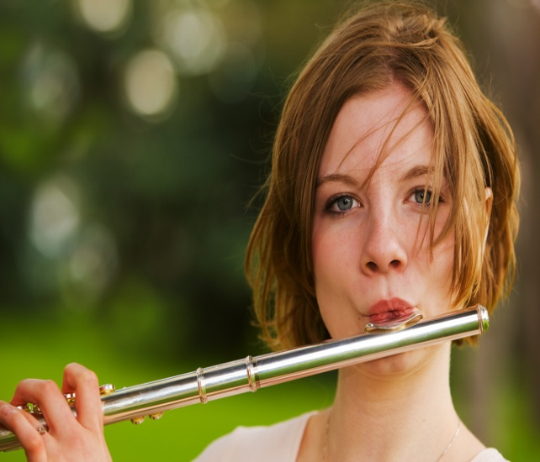
8th Grade
In this class we have 2 groups. One is the advanced. This group has prior experience playing an instrument. The other group is the beginners. Any 8th grade student with or without experience can join this class

Slide 4

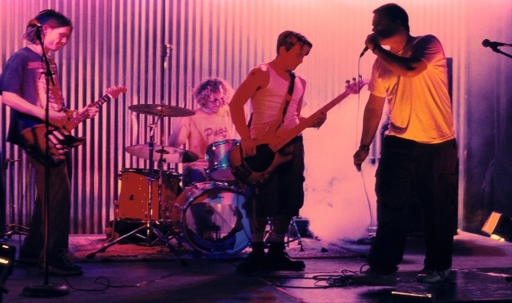
7th Grade
This class is similar to the 8th grade class. It has two groups: intermediate and beginning

Slide 5

6th Grade
Like 7th and 8th, this class may have 2 groups: Intermediate and beginners, no experience is required

Slide 6

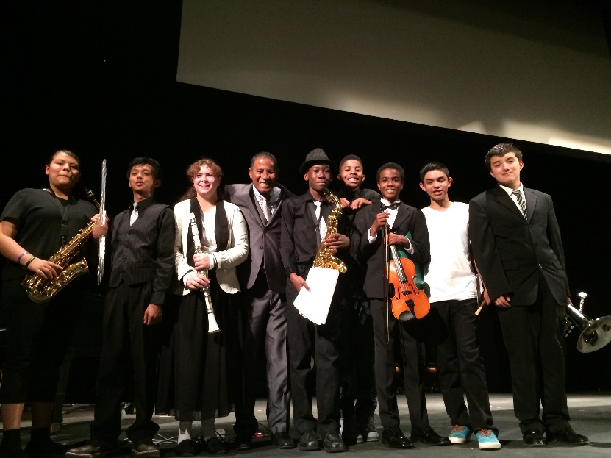
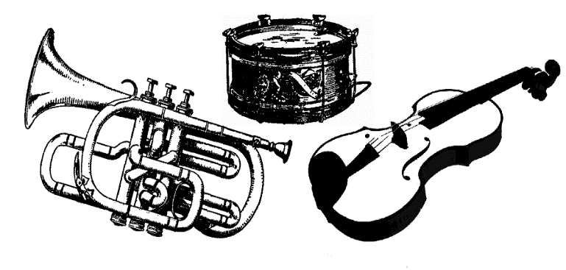
5th Grade
This class is for any 5th grader who is interested in learning how to play a band instrument. Like any other class, no prior experience is required.
Notes:
This class is for any 5th grader who is interested in learning how to play a band instrument. Like any other class, no prior experience is required.
5th Grade

